Slide 1
Commission to Reimagine the Future of New York’s Courts

Slide 2
The Commission
Chair:
Henry M. Greenberg
Members:
Hon. Rolando T. Acosta Seymour James, Esq.
Hon. Ariel E. Belen Brad S. Karp, Esq.
Mark A. Berman, Esq. Roger Juan Maldonado, Esq.
T. Andrew Brown, Esq. Hon. Edwina G. Mendelson
Hon. Anthony Cannataro Laurette D. Mulry
Hon. Michael V. Coccoma Jack Newton
Mylan L. Denerstein, Esq. Sharon M. Porcellio, Esq.
Hon. Craig J. Doran Paul C. Sanuders, Esq.
Richard A. Edlin, Esq. Paul Shechtman, Esq.
Hon. Michael J. Garcia Michael A. Simons, Esq.
Robert J. Giuffra, Jr., Esq Hon. Madeline Singas
Dennis E. Glazer, Esq. Hon. Leslie E. Stein
Alecia Walters-Hinds, Esq. Edward A. Steinberg, Esq.
Hon. Timothy C. Idoni Ari Ezra Waldman, Esq.

Slide 3
Definition of “Reimagine”
To imagine again or anew
especially: to form a new conception of: re-create

Slide 4

Accelerated preexisting trends in the legal profession
Revealed limitations in technological capacity

Slide 5
The mission of the Commission to Reimagine the Future of New York’s Courts’ is to research, analyze and make innovative proposals for the justice system of the future. To this end, the Commission shall consider regulatory and structural innovations, and enhanced use of technology and online platforms, to more effectively and efficiently adjudicate cases and improve accessibility, affordability, and quality of civil legal services for all New Yorkers. The Commission shall obtain widespread input through public comment sessions, targeted outreach, and the views of experts. The Commission shall think creatively and make practical, achievable recommendations that may be implemented — in the short-term or long term — by the Chief Judge or Legislature, as the case may be. The Office of Court Administration shall coordinate with the Commission and furnish such information and assistance as the Commission determines is reasonably necessary to accomplish its purposes.
Mission Statement

Slide 7
Guiding Principles
Focus on “consumers” of courts
Increase access to justice
More efficient delivery of services to litigants and other court stakeholders

Slide 8
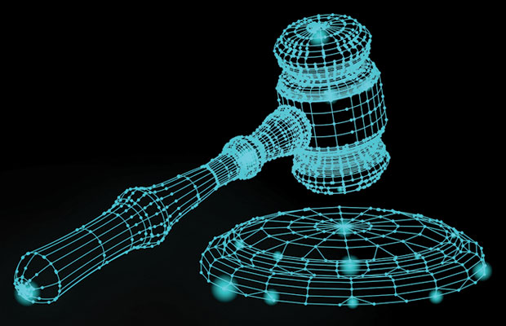
Build a Virtual Court System

Slide 9
Digital Transformation
More people in the world now have internet access than access to justice
More than half of humanity is now online
Society is experiencing a tsunami of technological changes and we are only at the beginning

Slide 10

Court system should leverage the digital revolution in society
Bring the court system into alignment with advances in the digital world.

Slide 11
Commission Processes
Full Commission meets every 5-6 weeks
Commission meetings will feature presentations by national experts & hearing presentations from working groups
Long-term and short-term projects
Public comment sessions & targeted outreach
Produce multiple reports and white papers

Slide 12
Commission Working Groups

Slide 13

Technology
Working Group

Slide 14
Work Plan
Distributed 79-page anonymous technological survey to 9,000 individuals associated with the Unified Court System
The survey poses questions on a wide range of topics, from overall usage of technology to cybersecurity to the use of mobile devices, with respect to all areas of civil and criminal litigation
Evaluate Court system’s technological capacity, by assessing hardware, software, automation, pain points that are causing issues to users, and other relevant issues

Slide 15

Online Courts
Working Group

Slide 16
Work Plan
Meet with stakeholders regarding the potential use of online court systems
16 states throughout the United States utilize online court systems
New York City’s Small Claims Court is developing an online dispute resolution (ODR) platform to resolve small claims disputes

Slide 17
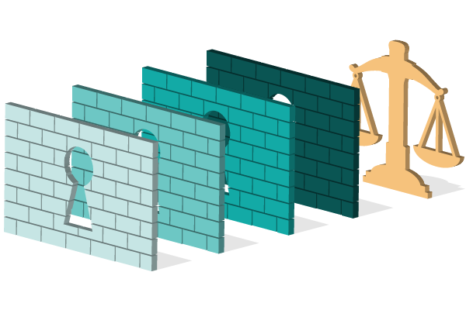
Regulatory Innovation
Working Group

Slide 18
Work Plan
Outreach to experts, review growing body of commentary and literature, and study what other states have done
The Working Group will initially study following topics:
  o What are the “needs” to be addressed and what “innovations” would best address such needs?
  o Should New York create a “Sandbox” to test proposed innovations, and, if so, how?
  o Should the Court Navigator program be expanded beyond housing Court and debt collection matters?

Slide 19
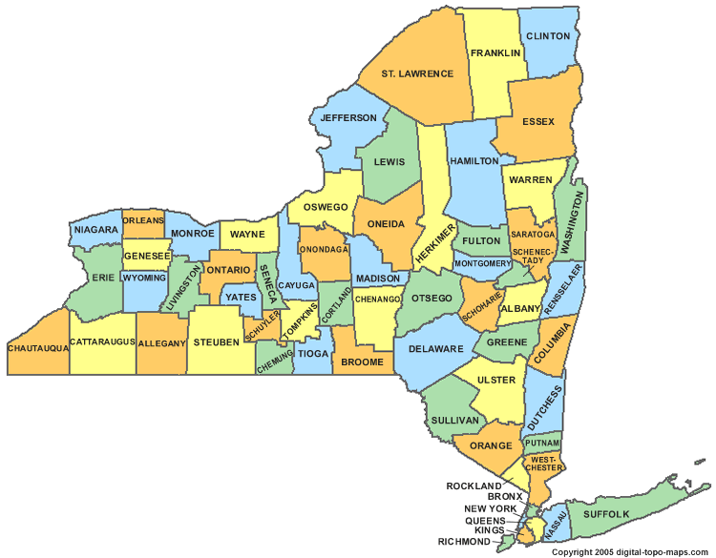
Structural Innovation
Working Group

Slide 20
Work Plan
Survey of Administrative Judges, requesting identification of the most critical structural/operational issues they confront
Consulting senior officials in the Office of Court Administration
Outreach to stakeholders, including New York State Association of Counties, District Attorneys Association, Public Defenders Association, County Attorneys, Sheriffs and other county agencies
Seeking information from experts, including the National Center for State Courts and the ABA’s Center for Innovation
Implement Statewide e-filing system

Slide 21
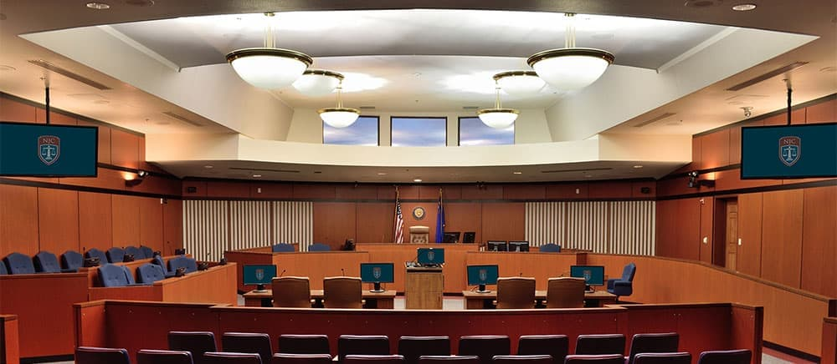
Trials
Working Group

Slide 22
Work Plan
Improving Grand Jury Practice
Trials of the Future
Improving/Streamlining Presentation of Evidence

Slide 23
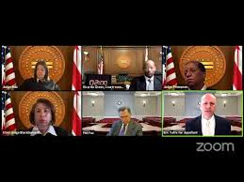
Appellate Practice
Working Group

Slide 24
Work Plan
Bring appellate courts to the same technological baseline.
Disseminate best practices, including:
  Hardware
  Software
  Cybersecurity
  Establish help desk ticketing system
  Staff training
Engage in future planning and think outside the box.

